Slide 1
Refresher on Issues in question production

Slide 2
Great assessment questions evolve – and continue to need revision

Slide 3
Good MCQ and EMQ writers’ checklist
Stems should:
give clinical context ‘vignette’
lead to clinical reasoning not recall
Lead in questions should:
be clear about the task
Distractors should:
look the same
not give obvious clues, discourage guesses
be unequivocally wrong in some respect

Slide 4
Question Writing Guidelines
Detailed guidelines for each course
Question templates
Assessment checklist

Slide 5
EULAR Assessment Checklist

Slide 6
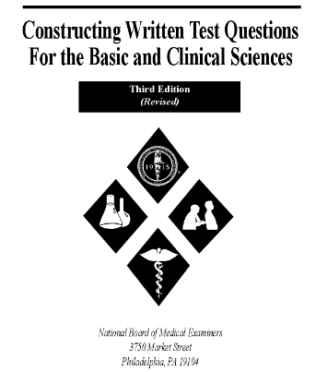
Case & Swanson Guide
http://www.nbme.org/publications/item-writing-manual.html

