Slide 1
26th Sonography Course – MSUS Intermediate Image requirement template

Slide 2
Application requirement – MSUS Examination
You are required to submit in total 6 normal ultrasound examination for the following joint regions:
Shoulder
Elbow
Wrist & Hand
Hip
Knee
Ankle & Foot
Please use the following powerpoint slides to insert the legend to the examination of the different joint regions.
If you require more slide pages, please just «Copy and Paste» the slides to insert similar slides.
Thank you!

Slide 3
Further instructions
The scans per joint regions should include all relevant structures for rheumatologists learnt in the Basic course
The EULAR Ultrasound Scanning Guide can be used as a reference. [http://ultrasound.eular.org/#/home]
Each slide must include both a longitudinal and transverse ultrasound scan demonstrating a particular anatomical structure
Each ultrasound image should include the initials of the bony landmarks and the most relevant structures that appear in the scan
A legend to the scan must be provided, including the anatomical area and scanning plane
No pathological scans are requested
Images must not contain patient data.

Slide 4
Check before you proceed to the next joint region...
Is the essential information presented?
Do slides ONLY show relevant data (remove all other)
Make sure NO patient data is shown
Have you included both a longitudinal and a transverse scan? – important for evaluation
Plain, white background slides are preferred
HELP: Link to the EULAR US scanning guide: http://ultrasound.eular.org/#/home

Slide 5
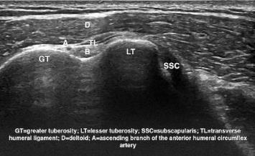
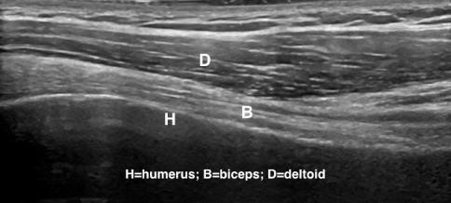
Shoulder
Example
Legend: transverse (left) and longitudinal (right) image of the long head of the biceps tendon in the humeral bicipital groove

Slide 6
Shoulder
Please insert your examination image here...
Please insert your legend here...

Slide 7
Shoulder
Please insert your examination image here...
Please insert your legend here...

Slide 8
Shoulder
Please insert your examination image here...
Please insert your legend here...

Slide 9
Elbow
Please insert your examination image here...
Please insert your legend here...

Slide 10
Elbow
Please insert your examination image here...
Please insert your legend here...

Slide 11
Elbow
Please insert your examination image here...
Please insert your legend here...

Slide 12
Wrist & Hand
Please insert your examination image here...
Please insert your legend here...

Slide 13
Wrist & Hand
Please insert your examination image here...
Please insert your legend here...

Slide 14
Wrist & Hand
Please insert your examination image here...
Please insert your legend here...

Slide 15
Hip
Please insert your examination image here...
Please insert your legend here...

Slide 16
Hip
Please insert your examination image here...
Please insert your legend here...

Slide 17
Hip
Please insert your examination image here...
Please insert your legend here...

Slide 18
Knee
Please insert your examination image here...
Please insert your legend here...

Slide 19
Knee
Please insert your examination image here...
Please insert your legend here...

Slide 20
Knee
Please insert your examination image here...
Please insert your legend here...

Slide 21
Ankle & Foot
Please insert your examination image here...
Please insert your legend here...

Slide 22
Ankle & Foot
Please insert your examination image here...
Please insert your legend here...

Slide 23
Ankle & Foot
Please insert your examination image here...
Please insert your legend here...

Slide 24
Finally, please ensure that you save
This powerpoint template as «First name».«Last name» in order that we are able to identify you properly.
Upload this powerpoint file when you apply for the course.
Good Luck! [EULAR School Admin; education@eular.org]

