Slide 1
33rd Sonography Course 2026, - MSUS Intermediate

Slide 2
PowerPoint requirements
You are required to submit standard ultrasound examinations for the following joint regions:
→ Shoulder, elbow, wrist & hand, hip, knee, ankle & foot.
For each region, please submit one examination, ensuring that all relevant structures are included.
This will total 6 ultrasound examinations.
The identify of the individual being scanned must be removed.
Please use these PowerPoint slides to insert the legend for the examination of the different joint regions.
If additional slides are needed, feel free to ‚copy and paste‘ to insert similar slides.

Slide 3
Further information
The scans for each joint region should encompass all relevant structures as taught in the basic course for rheumatologists.
The EULAR Ultrasound Scanning Guide may be referenced for guidance.
Each slide must include both longitudinal and transverse ultrasound scans showcasing a specific anatomical structure.
Each ultrasound image should clearly label the initials of the bone landmarks and the most relevant structures visible in the scan.
A detailed legend must accompany each scan, including the anatomical area and scanning place. Images must be anonymised, with no patient data included.

Slide 4
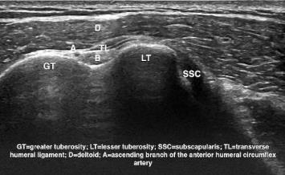
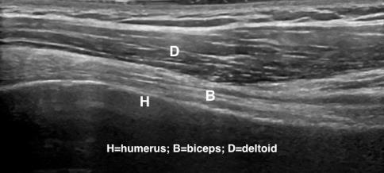
Example – Shoulder
Legend: transverse (left) and longitudinal (right) image of the long head of the biceps tendon in the humeral bicipital groove.

Slide 5
Shoulder
Please insert your legend here…

Slide 6
Shoulder
Please insert your legend here…

Slide 7
Shoulder
Please insert your legend here…

Slide 8
Elbow
Please insert your legend here…

Slide 9
Elbow
Please insert your legend here…

Slide 10
Elbow
Please insert your legend here…

Slide 11
Wrist & Hand
Please insert your legend here…

Slide 12
Wrist & Hand
Please insert your legend here…

Slide 13
Wrist & Hand
Please insert your legend here…

Slide 14
Hip
Please insert your legend here…

Slide 15
Hip
Please insert your legend here…

Slide 16
Hip
Please insert your legend here…

Slide 17
Knee
Please insert your legend here…

Slide 18
Knee
Please insert your legend here…

Slide 19
Knee
Please insert your legend here…

Slide 20
Ankle & Foot
Please insert your legend here…

Slide 21
Ankle & Foot
Please insert your legend here…

Slide 22
Ankle & Foot
Please insert your legend here…

